Slide 1
Parivartan Security and Deployment Topology

Slide 2







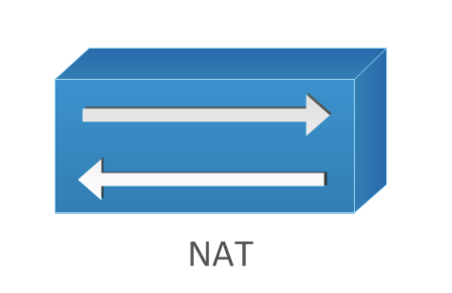

DC/DR Flow
Apigee Edge WAF, oAuth, Token Validation
(WAF, Siteshield, DNS)
3rd Party APIs
Leased Line
DMZ
Citrix LLB
SLB
Perimeter Firewall
SLB
Core Firewall
Core
Edge Firewall
TAS
DB Cluster
App Cluster
Ngnix cluster
NSX T0 Router
Oracle
DMS
Apigee Hybrid
Mongo
Kafka
Spring Cloud Gateway
Ngnix cluster
Redis Cache
Proxy Cluster
Spring Cloud
Microservices
jBPM
Elastic search
Drools
API Calls Via Internet
Web Portal URL Via Internet
API Calls Via Leased Line
Web Portal URL Via Leased Line

Slide 3
DC-DR failover
Assumption :
DC /DR will be Active /Standby
DC & DR will leverage the existing Public and Private IP address ranges for accessing the application
Existing Public and Private IP address range will be advertised /reachable either from DC or DR
For leased line users to access the application , subnet will be advertised from respective DC core router
There will be separate Ngnix Instance for Internet & Leased line users
There will be separate Ngnix Instance for SIT /UAT/ DEV & Prod environment
When DC is active , DR Internet facing links will be shut
Changes will be required at the following layers for proper failover
Network layer :
Components within parivarthan setup are deployed with non-overlapping IP addresses.
No changes are expected at this layer
Application layer
DB layer
External components ( Akamai/Apigee)
Existing Network devices within DC

Slide 4
Existing Network device within DC ( When DC is active)
DR Internet facing links will be shut
For leased line users to access the application , private subnet meant for accessing the parivarthan application will be advertised only from DC core router .

Slide 5
When DC is active , traffic from Internet End users will traverse the below Network &Security components
Internet link flow
For Ngnix access ( Internet)
End user → Akamai → DC Citrix NAT device →DC Perimeter Firewall → DC DMZ → SLB → Ngnix front end
For accessing application
Enduser → Apigee API Proxy → DC Citrix NAT device → DC Perimeter Firewall →DC Core Firewall →DC NSX Edge Firewall → TAS
Traffic from Intranet End users will traverse the below Network & Security Components
Leased line flow
For Ngnix access ( Internet)
End user → DC Core Firewall → DMZ → SLB → Ngnix front end
For accessing application
Enduser → DC Core Firewall → DC NSX Edge Firewall →Apigee API Proxy → TAS

Slide 6
When DR is Active
When DR is active , DC Internet facing links will be shut
For leased line users to access the application , private subnet meant for accessing the parivarthan application will be advertised only from DR core router . Any advertisement of private subnet from DC will be stopped

Slide 7
When DR is active , traffic from Internet End users will traverse the below Network &Security components
Internet link flow
For Ngnix access ( Internet)
End user → Akamai → DR Citrix NAT device →DR Perimeter Firewall → DR DMZ → SLB → Ngnix front end
For accessing application
Enduser → Apigee API Proxy → DR Citrix NAT device → DR Perimeter Firewall →DR Core Firewall →DR NSX Edge Firewall → TAS
Traffic from Intranet End users will traverse the below Network & Security Components
Leased line flow
For Ngnix access ( Internet)
End user → DR Core Firewall → DMZ → SLB → Ngnix front end
For accessing application
Enduser → DR Core Firewall → DR NSX Edge Firewall →Apigee API Proxy → TAS

